Slide 1
REDUNDANCY REDUCTION IN FACE RECOGNITION USING SINGLE SHOT DETECTOR
Guided By,
Mr.M.Vignesh,
Assistant Professor,
Department of Artificial Intelligence and Data Science,
Karpagam Institute of Technology,
Coimbatore.
Presented by
S.DHANUSH(721220243010)
V.KISHOR KUMAR(721220243027)
S.LINKEDH (721220243028)
S.VIMAL(721220243062)
Department of Artificial Intelligence and Data Science,
Karpagam Institute of Technology,
Coimbatore.

Slide 2
ABSTRACT
Facial recognition uses Computer-generated filters to transform face images into numerical expressions that can be compared to determine their similarity.
The Proposed system improved Viola-Jones face detection using Single Shot Detector Algorithm in order to reduce the redundancy rates.
Viola-Jones's algorithm has succeeded in determining the best face scale factor, but it produces a non-comparable face window that leads the redundant face detection.
Single Shot Detection algorithm significantly faster in speed and high-accuracy object detection algorithm. It exibits small convolutional filters to predict object classes and offsets to default boundary boxes.

Slide 3

EXISTING SYSTEM
VIOLA-JONES ALGORITHM:
The Viola-Jones algorithm is a widely used method for detecting objects in images, particularly faces. It uses a cascade of simple classifiers based on Haar-like features to quickly reject non-face regions and identify faces in an image.
Limited ability to detect faces at different scales, orientations, and lighting conditions.
Limited ability to detect faces with large variations in pose, expression, and occlusion.
High computational cost and large memory requirements for training and testing large cascades of classifiers.
LIMITATIONS :
Detection Rate
Training Time
Redundancy in Face Detection

Slide 4
PROPOSED SYSTEM (Combining Viola-Jones, HOG, and SSD)
The combination of Viola-Jones, HOG, and Single Shot Detector (SSD) for face detection offers several advantages over other methods Robustness, Speed, High accuracy and Adaption.
SSD is significantly faster in speed and high-accuracy object detection algorithm.
There are Three Basic methods used by Viola-Jones method which is as follows:
Haar-like features, Ada Boost, Cascade classifier
HOG stands for "Histogram of Oriented Gradients," a feature descriptor used in computer vision for object detection.
Benefits:
High Detection rate
Low Training Time
Improved Accuracy
Optimized to Consume Low Memory and Response Time

Slide 5
LIST OF MODULE
The Face Detector
(Module 1)
Data Scraping
(Module 2)
The Recognizer
(Module 3)

Slide 6
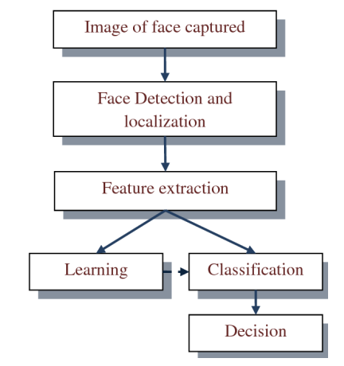
OVERALL ARCHITECTURE OF SYSTEM

Slide 7
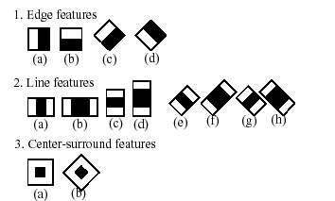
THE FACE DETECTOR
Faces are made of thousands of fine lines and features that must be matched. The Face Recognition using Python, break the task of identifying the face into thousands of smaller, bite-sized tasks.
The Main objective of facial recognition is to identify individuals, whether individually or collectively.
The Viola-Jones algorithm is a widely used method for real-time object detection in computer vision, particularly for detecting faces. It uses Haar-like features and a cascaded classifier to quickly and accurately identify objects in an image.
Haar-Features

Slide 8
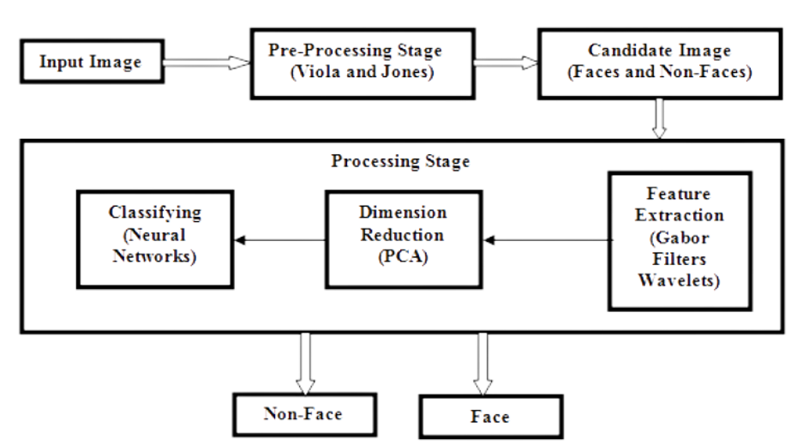
Data Flow Diagram for Face Detector

Slide 9
DATA SCRAPING
Collect images of faces, with consent and proper permissions, through various sources such as photographs, video footage or online platforms.
Ensure that the images are diverse in terms of demographics and poses. Store the images in a secure location for further processing and analysis using face recognition algorithms.
Be mindful of ethical considerations such as privacy and consent, and ensure compliance with relevant regulations and laws. Also, ensure that the collected data is labeled and annotated properly for accurate training and testing of the recognition algorithms.
Data augmentation techniques can also be used to increase the diversity of the dataset.

Slide 10
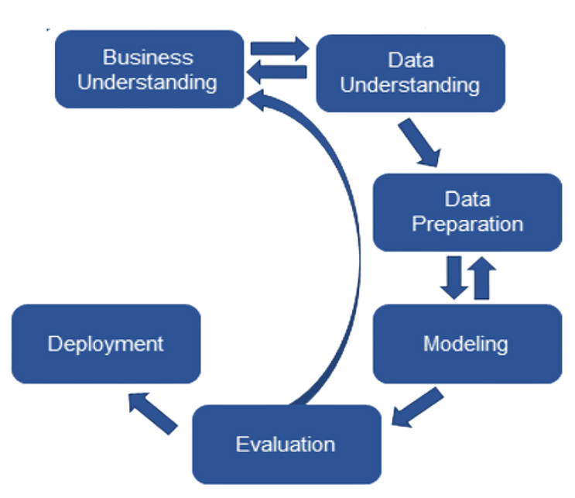
Data Flow Diagram for Data Scraping

Slide 11
THE RECOGNIZER
Face recognition is a process of identifying or verifying the identity of a person using their face.
Single Shot Multi Box Detector (SSD) is a popular object detection algorithm that can be used for face detection. It is a fast and accurate algorithm that can detect objects in images. It uses a single deep neural network to predict bounding boxes and class probabilities for multiple objects in an image.
HOG is an algorithm used for feature extraction in computer vision. It is used to extract features such as edges, corners, and textures from images. It calculates the gradient of an image in multiple orientations, and creates a histogram of the gradient orientations. These histograms can then be used as features for object detection or recognition.

Slide 12
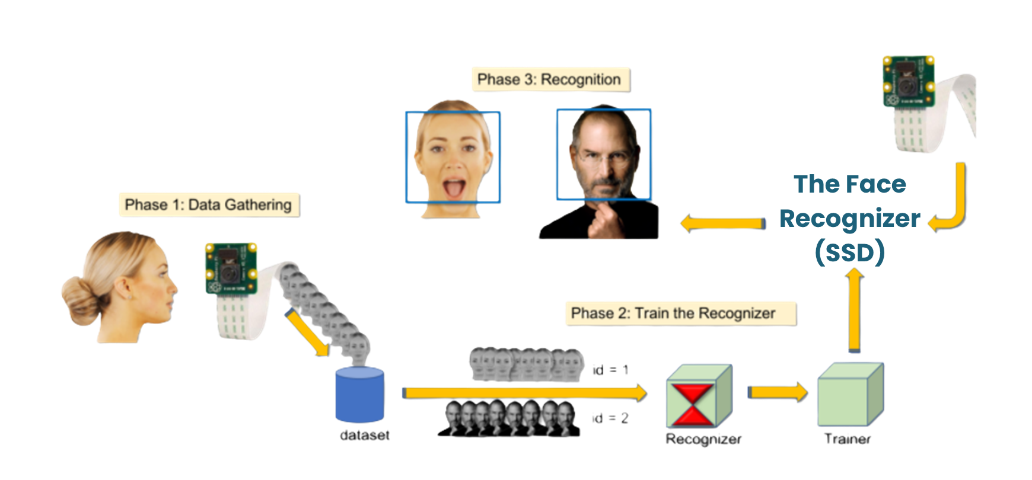
Data Flow Diagram for Recognizer
1 2

Slide 13

SAMPLE SOURCE CODE

Slide 14
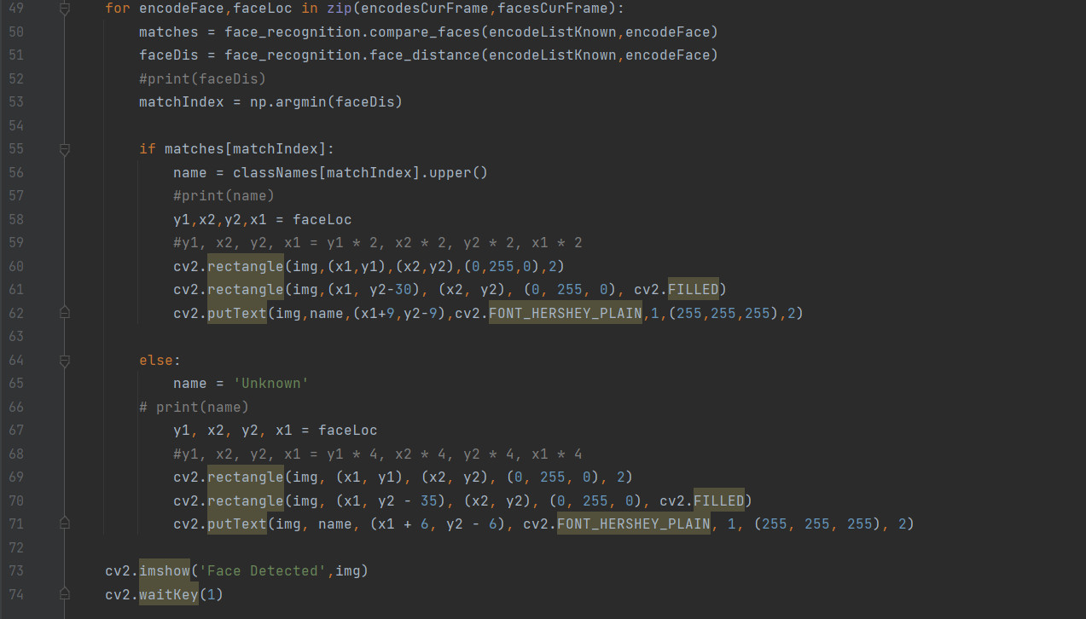
SAMPLE SOURCE CODE

Slide 15

IMPLEMENTATION SCREENSHOTS
Image Input
A face recognition project uses images or video frames of faces as input, which are captured by a camera or video device. The system analyzes the input and extracts features unique to each individual such as facial shape, texture and uses them to identify or verify the person. The output is a binary decision or a confidence score indicating the likelihood of a match.

Slide 16
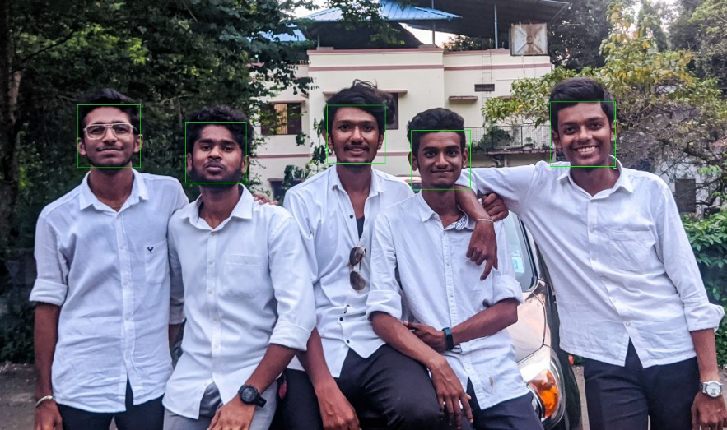
IMPLEMENTATION SCREENSHOTS
Faces Detected in the Input
The output of a face detector in a face recognition project is a set of coordinates, usually in the form of a bounding box, that indicate the location of the face in the input image
It also includes a confidence score indicating the likelihood that the detected region is a face. The output is used as input for the next step, which is face recognition.

Slide 17

IMPLEMENTATION SCREENSHOTS
Data Collected for the Encoding Faces
Data collection in a face recognition project involves gathering images or video frames of faces from different individuals, which will be used to train and test the system.
The data should be labeled with the appropriate information for each individual, such as their name or ID.

Slide 18
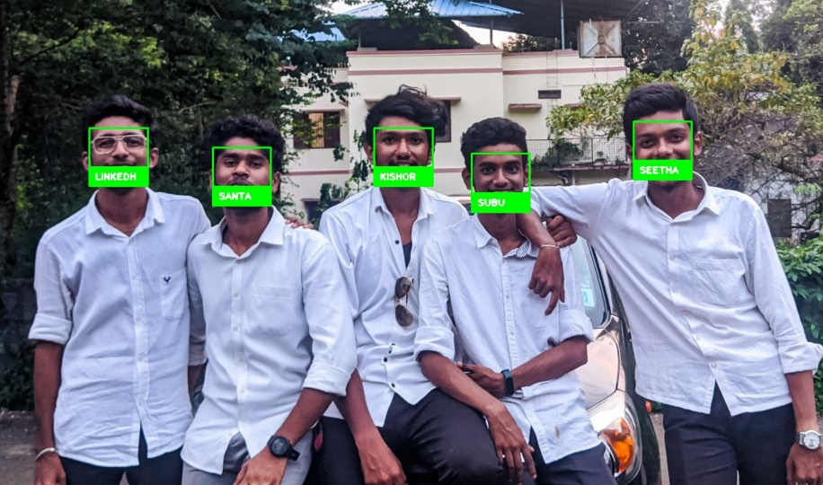
IMPLEMENTATION SCREENSHOTS
Face Recognition with Names
The output of a face recognizer in a face recognition project is a binary decision or a confidence score indicating the likelihood of a match between a given face and the faces in the database.
It also includes the identification of the person matched, if any. The output can be used for different purposes such as access control, security or identification

Slide 19
REFERENCE
Kartika Candra Kirana, Slamet Wibawanto , Heru Wahyu Herwanto
REDUNDANCY REDUCTION IN FACE DETECTION OF VIOLA & JONES USING THE HILL CLIMBING ALGORITHM
2020 THE 4TH INTERNATIONAL CONFERENCE ON VOCATIONAL EDUCATION AND TRAINING
Mangayarkarasi Nehru, Dr. Padmavathi S.
ILLUMINATION INVARIANT FACE DETECTION USING VIOLA JONES ALGORITHM
International Conference on Advanced Computing and Communication Systems (ICACCS -2017), Jan. 06 – 07, 2017
D.Shamia, D.Abraham Chandy
ANALYZING THE PERFORMANCE OF VIOLA JONES FACE DETECTOR ON THE LDHF DATABASE
International Conference on Signal Processing and Communication (ICSPC’17) – 28th & 29th July 2017
Mohammad Da'san, Amin Alqudah and Olivier Debeir
FACE DETECTION USING VIOLA AND JONES METHOD AND NEURAL NETWORKS
2015 International Conference on Information and Communication Technology Research (ICTRC2015)
Liu, Wang, and Li
RECENT ADVANCES IN DEEP LEARNING FOR FACE RECOGNITION
IEEE Transactions on Image Processing (2018)

Slide 20
WEB REFERENCE
https://towardsdatascience.com/ssd-single-shot-detector-for-object-detection-using-multibox-1818603644ca
https://towardsdatascience.com/viola-jones-algorithm-and-haar-cascade-classifier-ee3bfb19f7
https://medium.com/@ageitgey/machine-learning-is-fun-part-4-modern-face-recognition-with-deep-learning-c3cffc121d78
https://aws.amazon.com/what-is/facialrecognition/#:~:text=It%20works%20by%20
identifying%20and,large%20collection%20of%20existing%20images.

Slide 21
THANK YOU!

